Slide 1
Discussion: Endogamy…how it’s messing with my DNA research Presented by Alvin Holtzman for Albuquerque Genealogical Society March 16, 2024 inkwell177@aol.com
Notes:
Hello everyone. Endogamy can present a major challenge for us genealogists. We all have had some level of endogamy in our family history, perhaps going back many thousands of years. But, for the most part, this has not been an ongoing phenomena. We’ll review what is endogamy and then review some strategies to assist our understanding of our shared matches.

Slide 2
Endogamy definition: When intermarriage from within a community of ancestors has occurred over many, many generations…even centuries.
Usually based on religious or cultural practice or geographical reasons.
Some example groups:
Ashkenazi Jewish, Amish, French Acadians, Polynesian Islanders and Native Americans.
Notes:
Endogamy can be defined as marrying within your own community over dozens of generations. When we talk about intermarriage, we’re usually talking about cousins marrying cousins. Sometimes first cousins, but most likely it’s 2nd, 3rd, 4th, 5^{th or tenth} cousins. In the world today, the most endogamic countries are Moslem or Jewish. Ashkenazi are Jews who come from a very small group of Jews (the founders) in Europe about 1,000 years ago. They did not marry out side of their group. So that’s 40 generations of the same DNA. Other examples of endogamous people are the Amish, French Acadians, Islanders and Native Americans. As genetic genealogists we have to deal with the cumulative effect of this phenomina. So the key ignitors are religious, cultural practice and geographic confinement.

Slide 3
How does Endogamy differ from Multiple Relationships or Pedigree Collapse?
Multiple Relationships or Pedigree Collaspe:
When the same couple appears multiple times in your tree, such as great grandparents
Example – two people are first cousins both from their mother’s and father’s sides. Perhaps two brothers married two sisters.
Notes:
Before we go on, let’s talk about pedigree collapse. This is different than endogamy. It’s usually easier to deal with when reviewing our matches. An example is when two brothers marry two sisters. That’s a collapse in the tree.

Slide 4
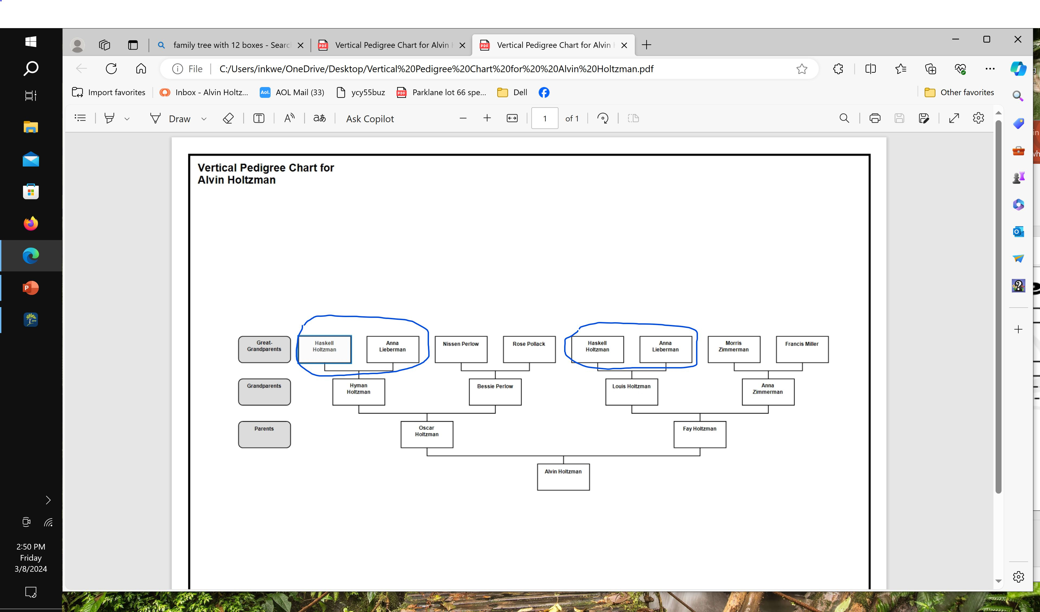
Notes:
Here’s a fictitious family tree with two first cousins marrying and having little Alvin. So now Alvin has only three sets of great grandparents rather than 4. In this example, Alvin Holtzman would expect to inherit more DNA (about twice more) from the double dose great grandparents than the other single dose great grandparents. When this event is within the last few generataions it’s easier to work with. Somewhere in the past, we all most likely have such an event but don’t have the documentation.

Slide 5
What’s the effect of multiple relationships or pedigree collapse on your autosomal DNA matches?
Your total shared centamorgans will be inflated with another individual.
Example: a double first cousin could share about 1,700 total cM, rather than the usual average of 866 cM. This throws off the predicted relationship.
But, it’s a one time event that you can work through.
Pedigree collapse is more confusing to work out. It’s actually a mini endogamous event.
Notes:
The effect is that your DNA sharing with your match will be overstated. A double first cousin could share about 1,700 total cM, rather than the usual 866 cM. This is usually a one-off and often known by the genealogist so that the overstatedness of the relationships can be taken into account. In case you are not aware, there are about 7,000 cM in each of us. If we were identical twins we would share 7,000 cM. Each parent contributes about 3,500 cM. A sibling shares about 2,600 cM. A grandparent shares an average of 1750 cM.

Slide 6
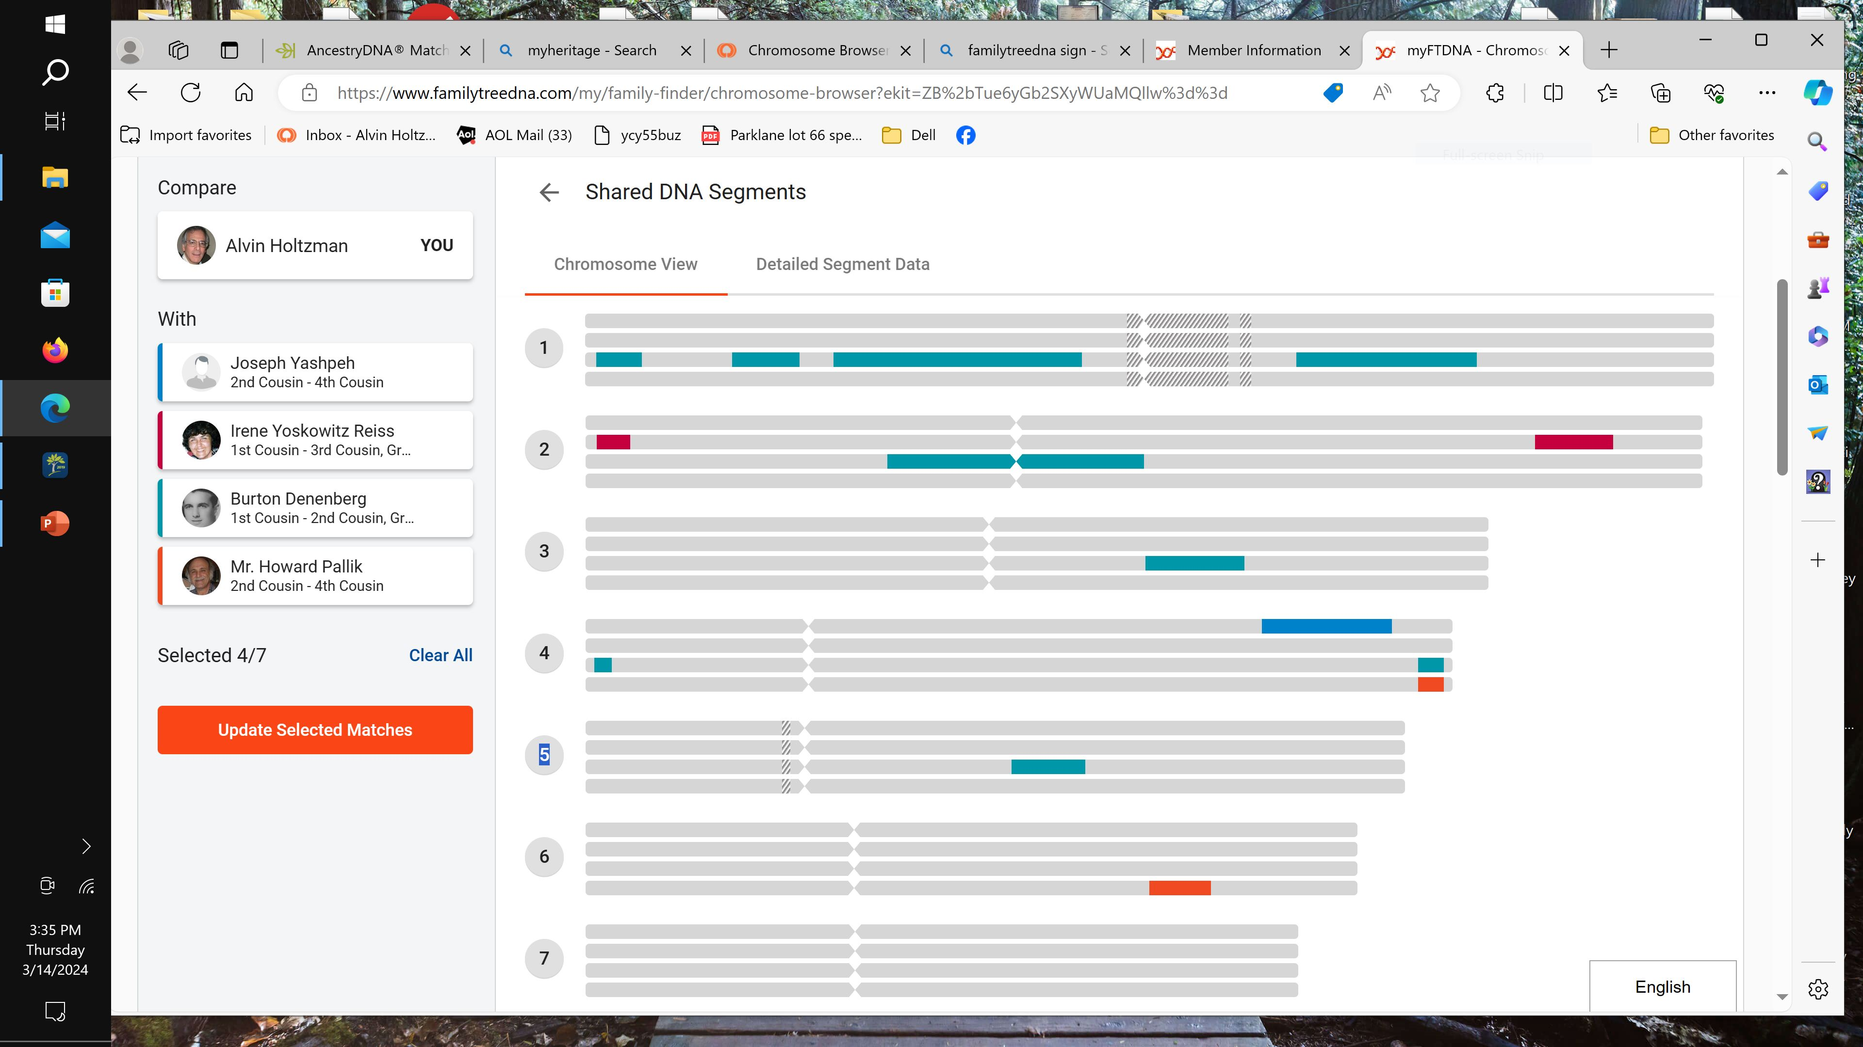
Chromosome Browser
Notes:
Here’s a partial view of the Chromosome browser. The Browser can be a very useful tool. The browser shows all 22 autosomal genes but I only had room to view the first 7 chromosomes here. It illustrates just where you share DNA with your match. Each colored bar represent a segment length. They show where I match to my match. You can see some are longer than others. The larger the segment, the closer relationship.

Slide 7
Endogamy is pedigree collapse on steroids
The same group of people keep marrying within their group for centuries.
Nearly all matches are overstated | A typical match could be related multiple ways…. Ie. 2nd cousin as well as a third, fourth and fifth cousins | Endogamous peoples have many more matches than non-endogamous people. | Compounding all this is the lack of available documentation.
Notes:
Endogamy is pedigree collapse on steroids. It’s especially noticeable starting past 2nd cousins. Someone who is projected to be a 3rd cousin, may really be a 4th, 5th or even10th cousin. I currently have over 168,000 matches on ancestrydna.com. That’s probably at least three to five times as many as those who do not have to deal with endogamy. So, when I look at my match, I have difficulty connecting them to my tree. I most often have no common surnames names and NO documentation (ie census records, birth, marriage etc) to substantiate the connection. Most Ashkenazi Jews were not mandated to adopt last names until about 1800. As we work to find the common ancestor, the best clue is a common location such as a town or small region (not country because those borders changed often.)

Slide 8
Endogamy is very, very sly and not obvious
- Usually no immediate ancestors who are duplicated
- Many identical ancestors going back dozens of generations
- Repeatedly marrying within the same group
- Many matches at lower cM segment size due to identical by state recombination (rather than identical by descent)
- Significantly more smaller segment matches than non-endogamous groups
Notes:
Endogamy is very sly and certainly not obvious. With the last 40 generations of Ashkenazi Jews marrying each other, the cumulative effect is staggering and mind bending. Nearly all Ashkenazi have matches that don’t link to one common ancestor. Rather we have multiple common ancestors. Endogamous people share many more smaller segments than non-endogamous people. This sharing can be put into two groups. Identical by State means a particular segment is commonly found in the entire database of like testers, such as an identifyable ethnicity like Ashkenazi. Identical by descent is considered a better barometer leading to a common ancestor.

Slide 9
How DNA testing companies respond….
- Removed segments below 6 cM
- Removed many Identical By State matches
- Developed improved relationship predications
Notes:
Initially, endogamous testers were receiving very over stated relationships. For instance, many matches were coming up as 2nd cousins but in fact were more like 4th cousins. Ancestry, for instance, uses what they call Timber. It reduces the total cM by removing DNA commonly found in all Ashkenazi and tries to leave in the cM that reflect IBDescent.

Slide 10
Shared cM Tools
DNA Painter – Shared cM tool
SEGCM
Notes:
A couple of good tools freely available are the Shared cM tool found on DNA Painter and SEGCM.

Slide 11
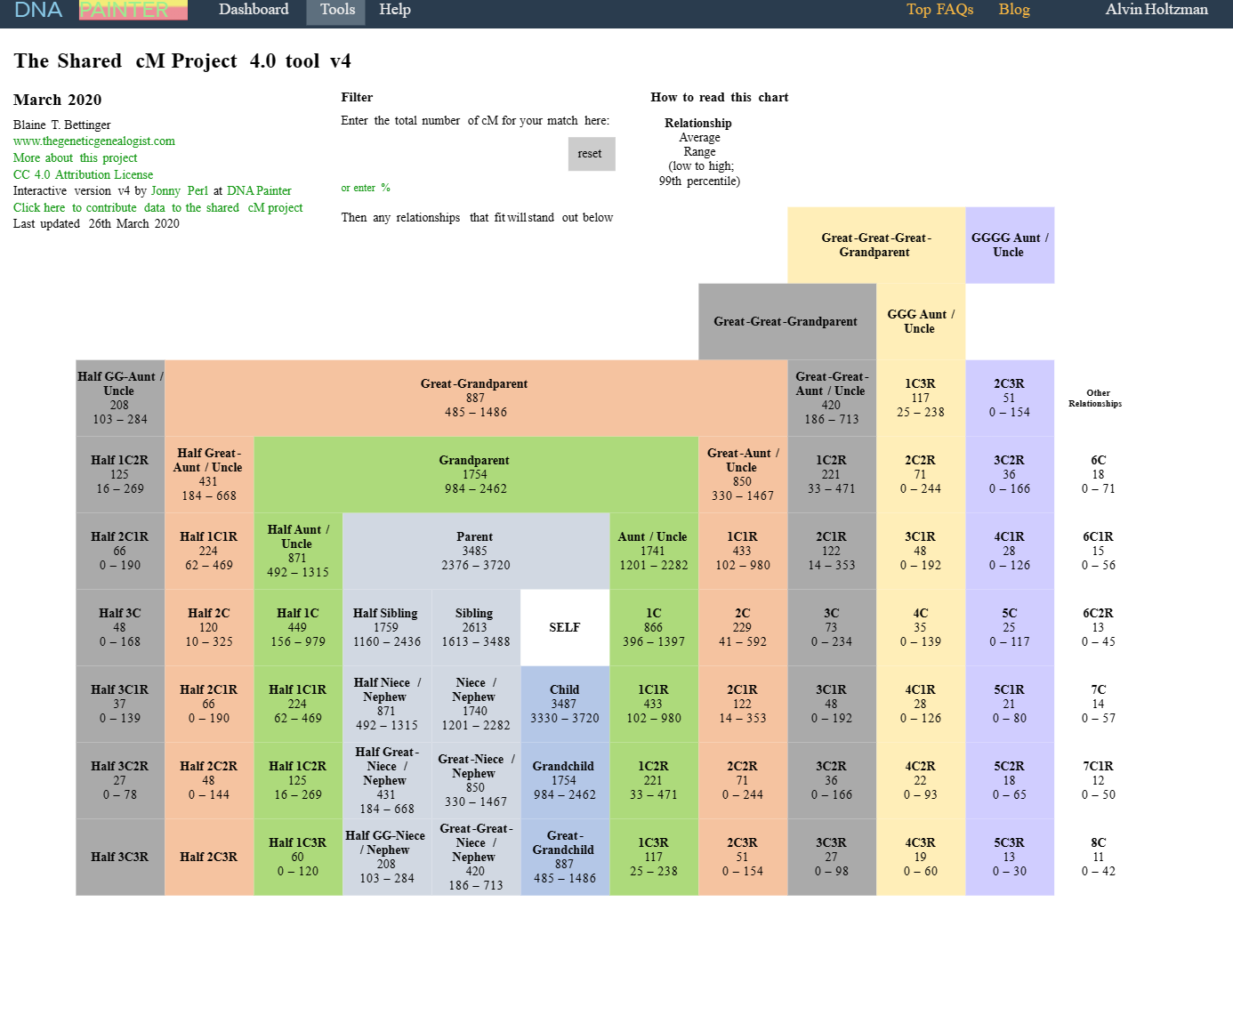
Notes:
This is the basic Shared cM Tool found on DNA Painter. You plug in your total centimorgan amount and it calculates possible relationships. Each level is a generation. The level above yourself is older than you. The level below is younger.

Slide 12
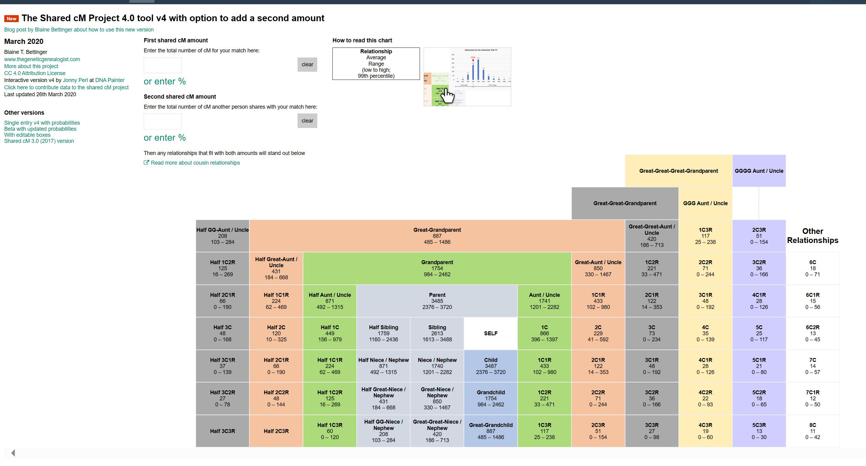
Notes:
This is a new version of the Shared cM Tool that refines a relationship with a match by inputting a 2nd match’s shared cM, such as a sibling of yours. For instance, I may share 200 cM with a particular match and my sister shares 150 cM. The Shared CM tool will reflect the difference in sharing and project a potentially better relationship.

Slide 13
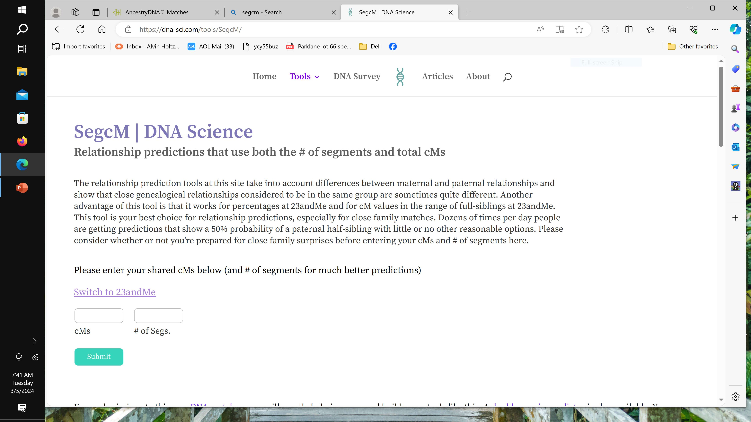
Notes:
This is the SegcM Tool found at dna-sci.com/tools.segcm/. This tool incorporates the total cMs shared with your match AND the number of segments shared with your match. The number of segments shared with your match can sharpen your projected relationship.

Slide 14
Strategies
Focus on your best matches
Use the 100 – 20 – 10 - 10 guideline
100 total cM with at least a 20 cM largest segment
Followed by at least a pair of 10 cM segments
Notes:
For those DNA companies who allow you to see the Chromosome Browser, you can see the top three segment lengths. We have to modify this guideline for ancestrydna (and currently for 23andme) who do not provide us with that information. People whose longest segment match is less than 20 cM are usually related further back. I use the 100-20-10-10 guideline. After you have exhausted these top prospects, then you can back off this guideline if necessary.

Slide 15
Strategies
Focus on those matches who offer the best result
For AncestryDNA.com
Use the 100 – 20 guideline
100 total cM with at least a 20cM longest segment.
AncestryDNA utilizes Timber which omits pile-up regions that are found in vast populations.
The Timber algorithm kicks in below 90 cM
And Employ the Ratio Method
Total cM divided by # of segments
We like fewer segments
10 cM or higher such as 12 cM priority
Notes:
Since ancestrydna and currently 23andme only reveal the total cM and longest segment, we have to adjust the guideline. Use the 100-20 guideline. Ancestry attempts to filter out the Identical by State matches. These are the smaller segments. They call it Timber. It kicks in at 90 cM. All shared matches below the total cM amount of 90 are processed through their Timber Algorithm. Additionally, we can calculate an average segment size. Take the total cM sharing and divide by the number of segments. Bigger segment size is good. It means your relationship to the match is closer. In this slide I state 10 cM or higher. Actually, I would recommend you try an average of 12 cM segments.

Slide 16
Shared DNA Examples
Match #1 100 total cM with a 20 longest segment;
6 total segments = 13.3 cM average
-------------------------------------------
Match #2 100 total cM with a 12 longest segment;
10 total segemnts = 8.8 cM average
Notes:
Here are two examples of DNA sharing at the lower end. Each shares 100 cM with the match. Match #1 is the potentially the closer relationship because of the longest segment size of 20 and a 13.3 cM average length of the other segments vs Match #2’s longest segment is only 12, and a lower average cM shared.

Slide 17
Strategies
Build out your matches family trees
Notes:
As you know, not everyone includes family trees in their DNA account. If possible, build out their family trees to help identify the potential connection to you. I have done this many, many times and have a good success rate. And, success in genetic genealogy is always reliant on a paper trail.

Slide 18
Let’s visit some sites
AncestryDNA.com
23andme.com
MyHeritage.com
Familytreedna.com
GEDmatch.com (Tier 1)
DNA Painter (WATO +)

Slide 19
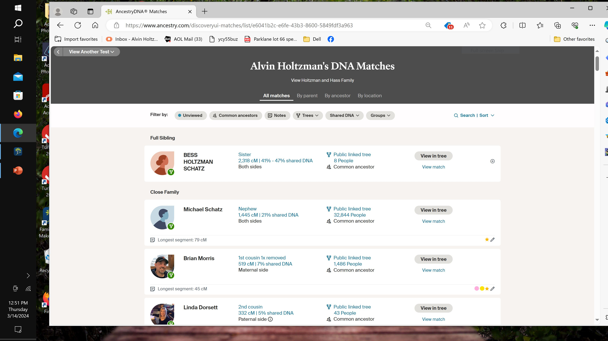
Notes:
This is ancestryDNA. These two happen to be my closest matches. The tabs running across the top can be helpful, but not “common ancestors”. Remember, endogamous people share multiple relationships with their matches. When you click on “Shared DNA”,

Slide 20
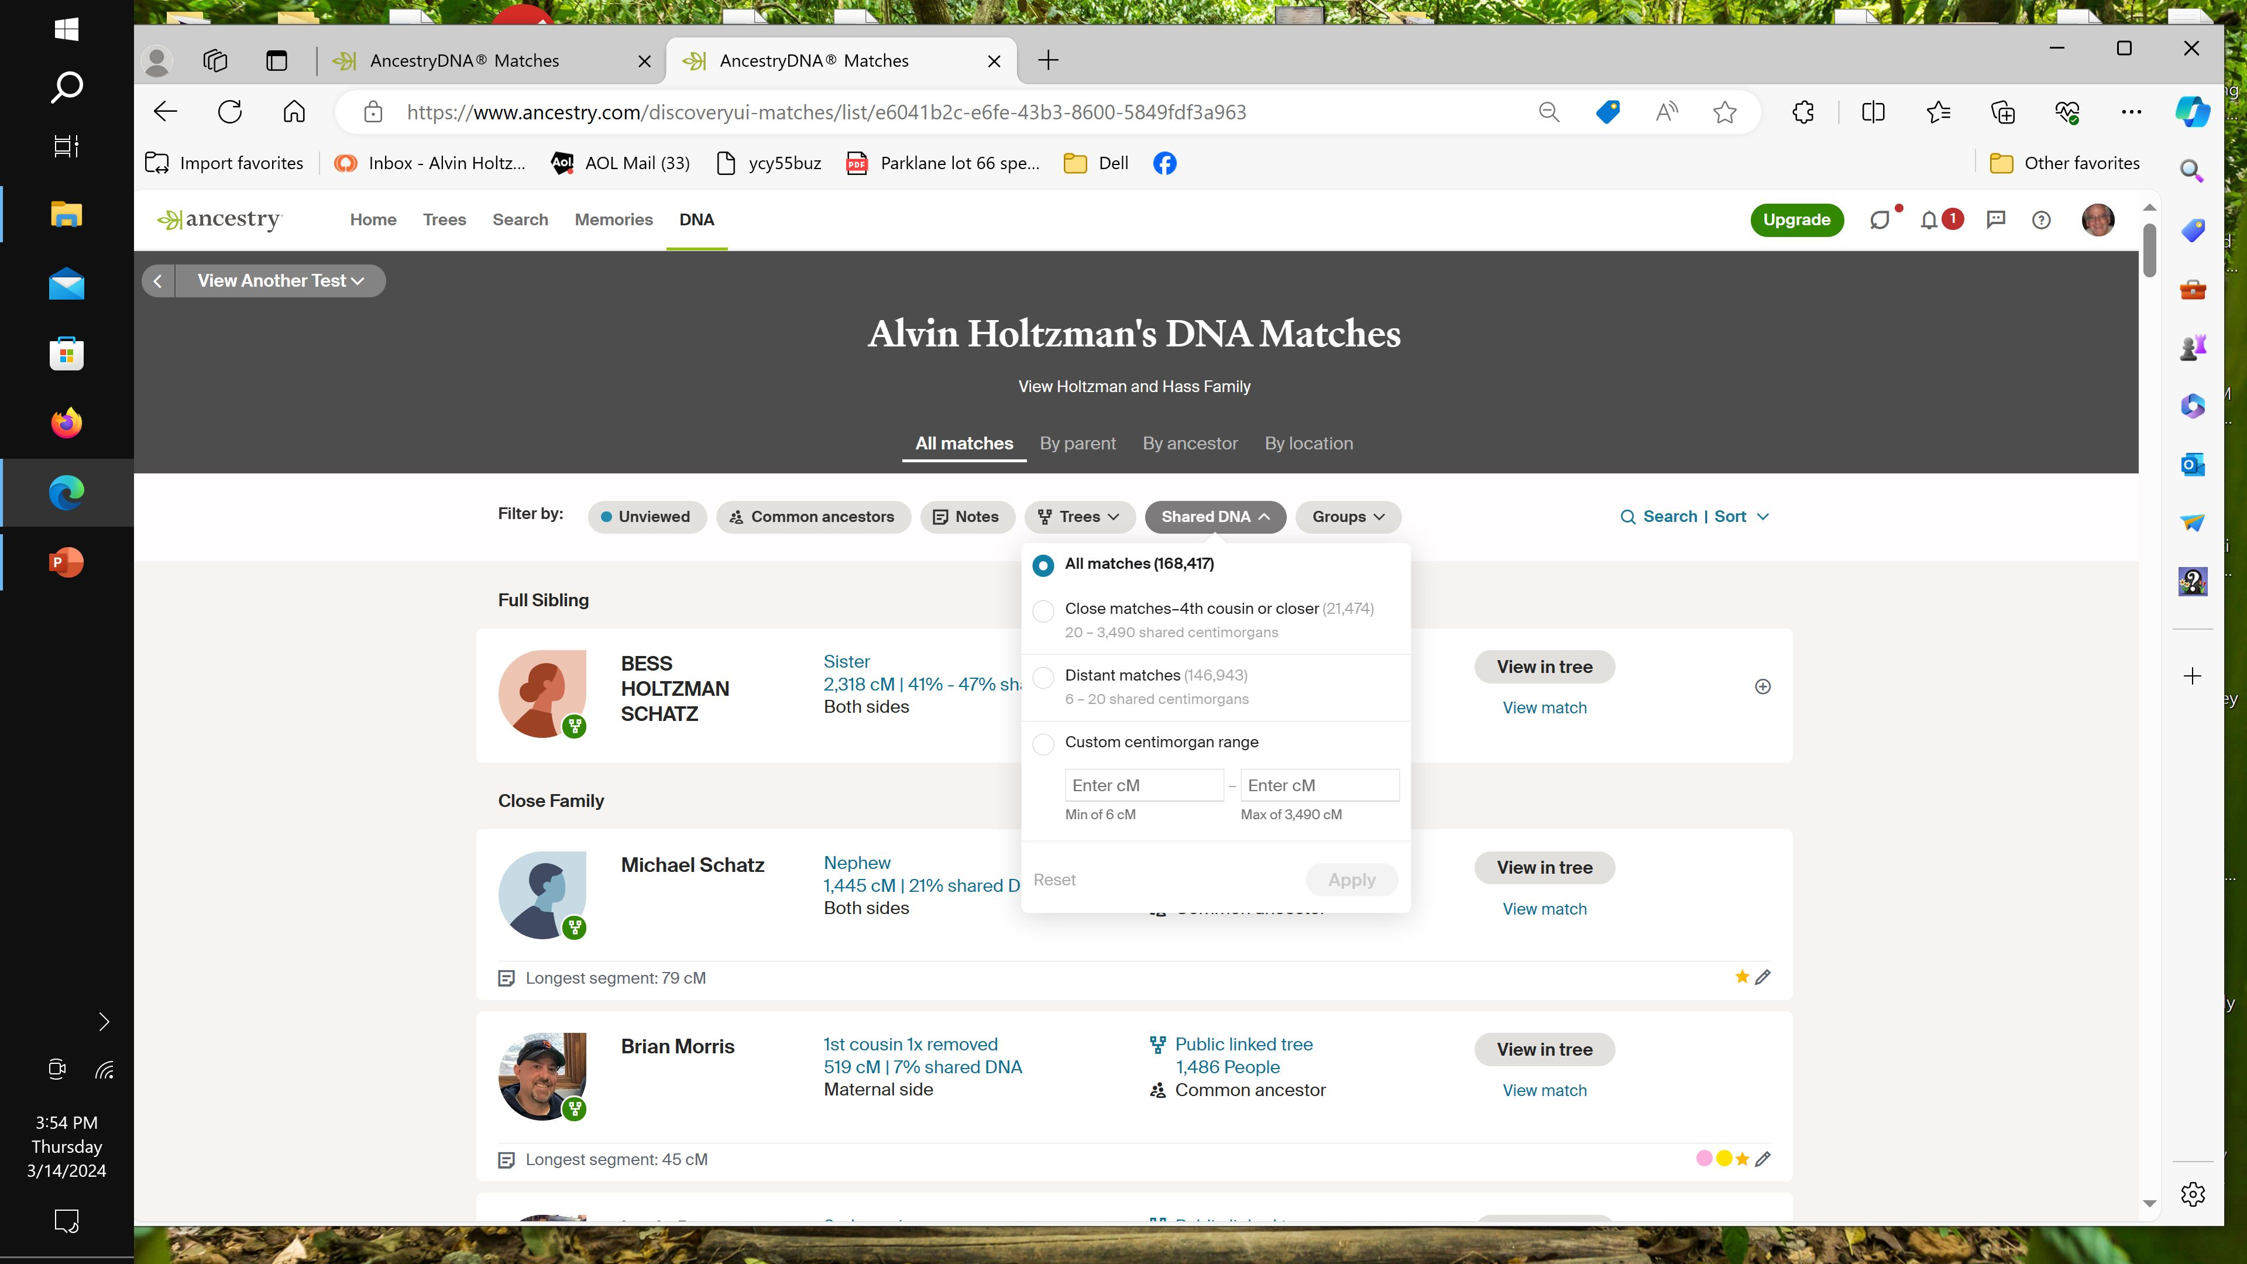
Notes:
If you’re wondering how many matches you have, click on the “Shared DNA” tab. I currently have 168,417 matches. Of those 21,474 are considered to be 4th cousins or closer.

Slide 21
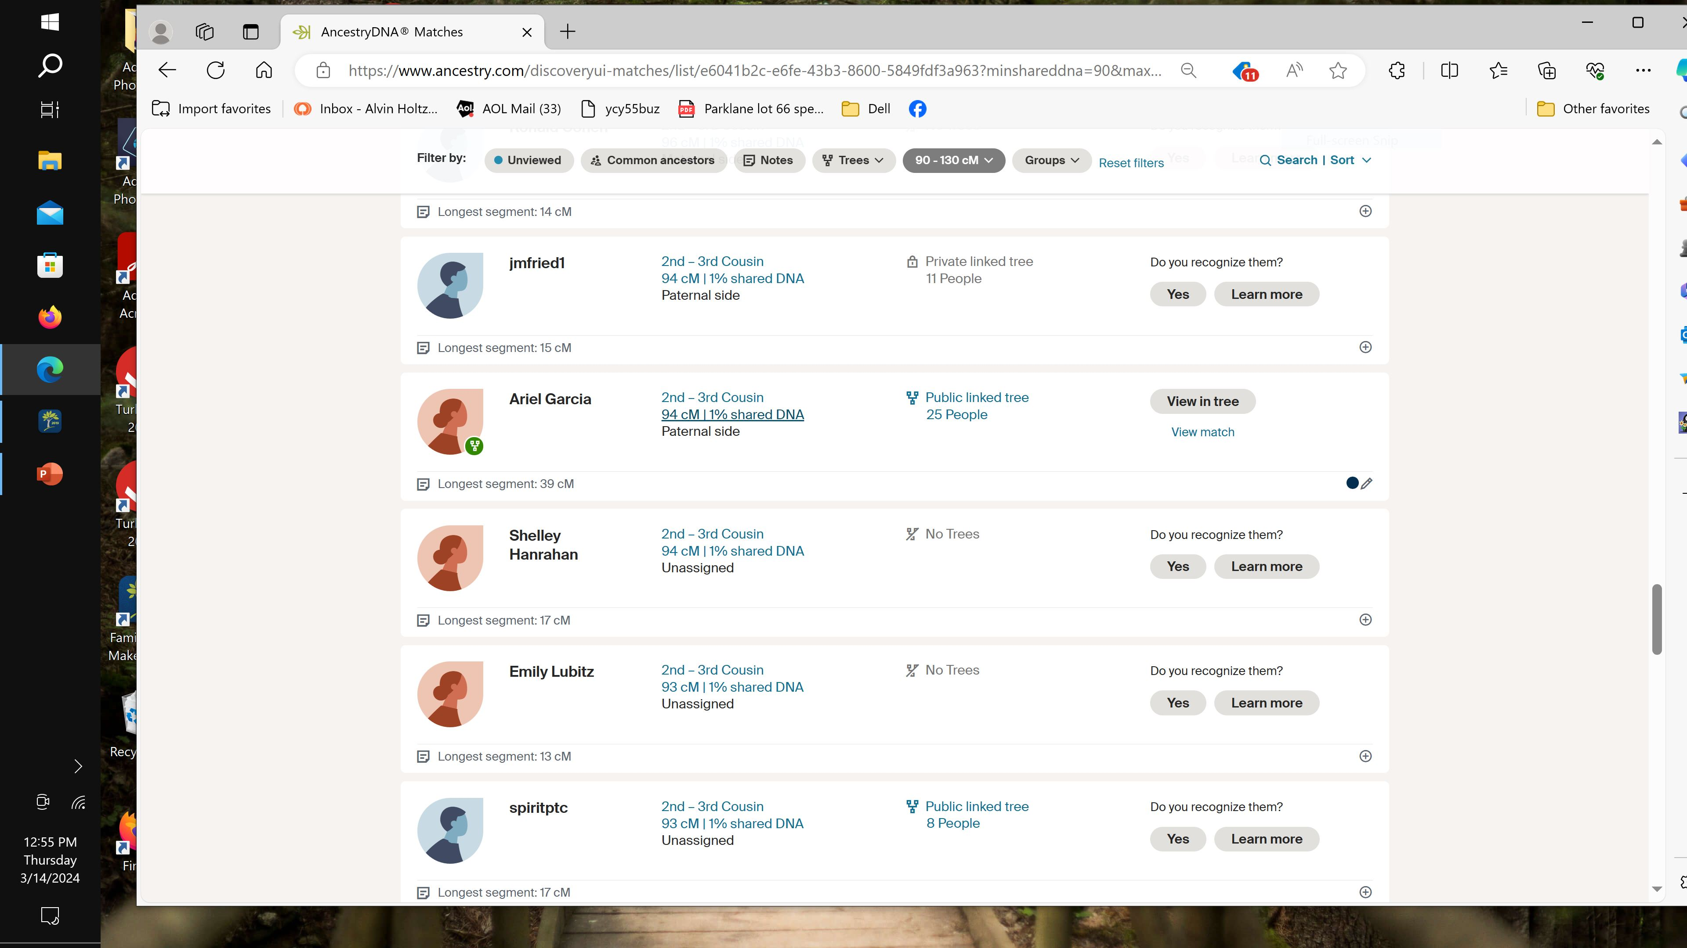
Notes:
This is a screen shot of a few matches between 90 and 100 cM sharing. Fewer than 90 cM go through the Timber process. Yes, it’s below my guideline of 100 total cM. But, of these matches one might be worth pursuing. Ariel shares a longest segment of 39 cM and has a total of 94 cM.

Slide 22
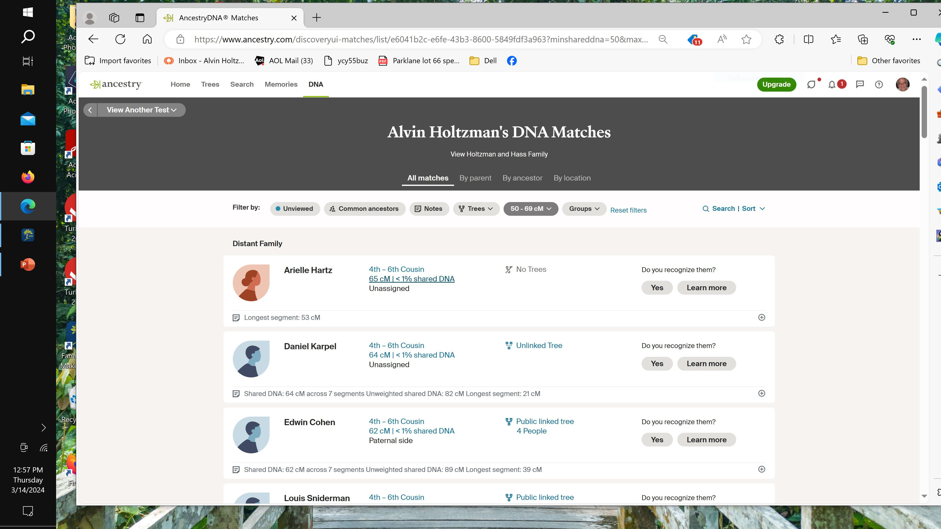
Notes:
Here’s a couple of matches who have been processed with the Timber Algorithm. By clicking on the 65cM line we get more information.

Slide 23
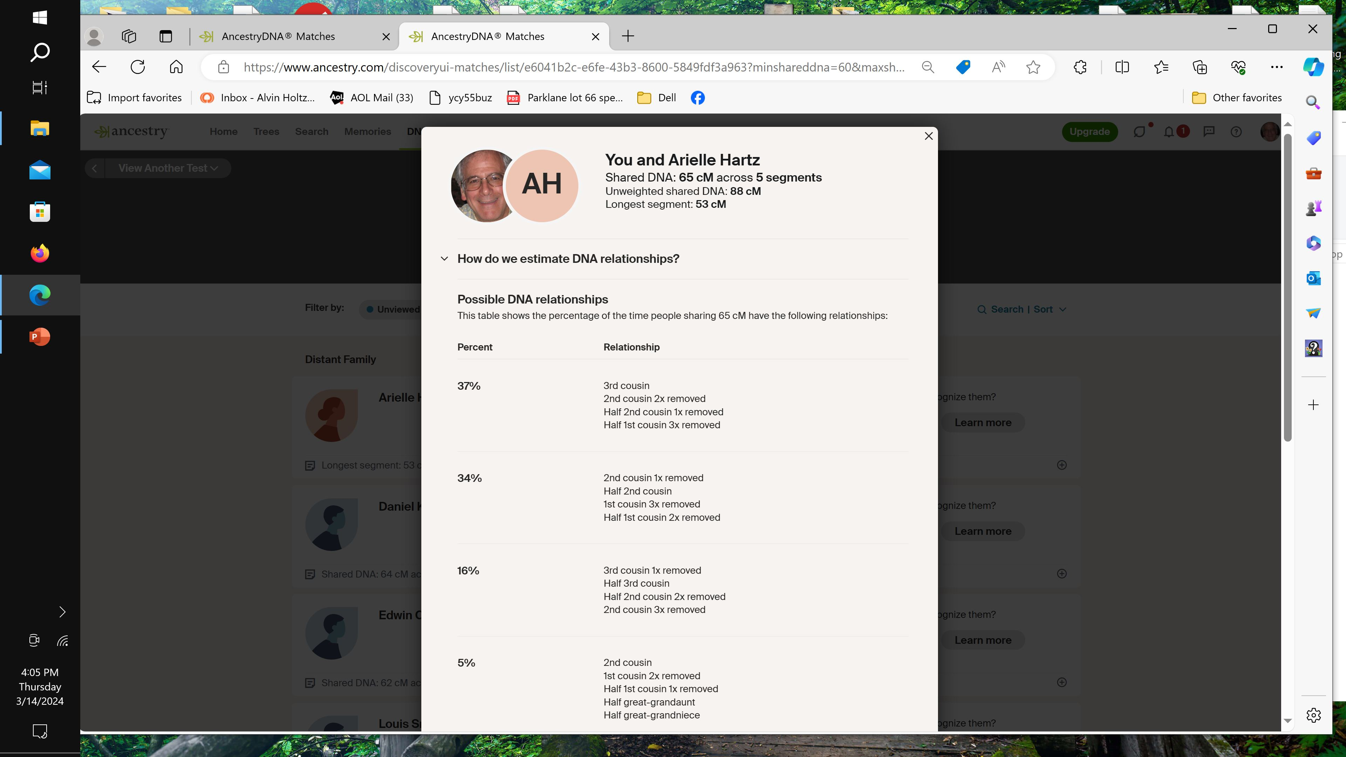
Notes:
This match started out with us sharing 88 cM. Ancestry’s Timber algorythm reduced sharing to 65 cM. But, take a look at the longest segment. A very impressive 53 cM. And there are only 5 total segments. And, ancestry supplied possible relationships. Although not in my first priority, After I’ve gone through my top matches, I would certainly work on this match to identify an ancestor link.

Slide 24
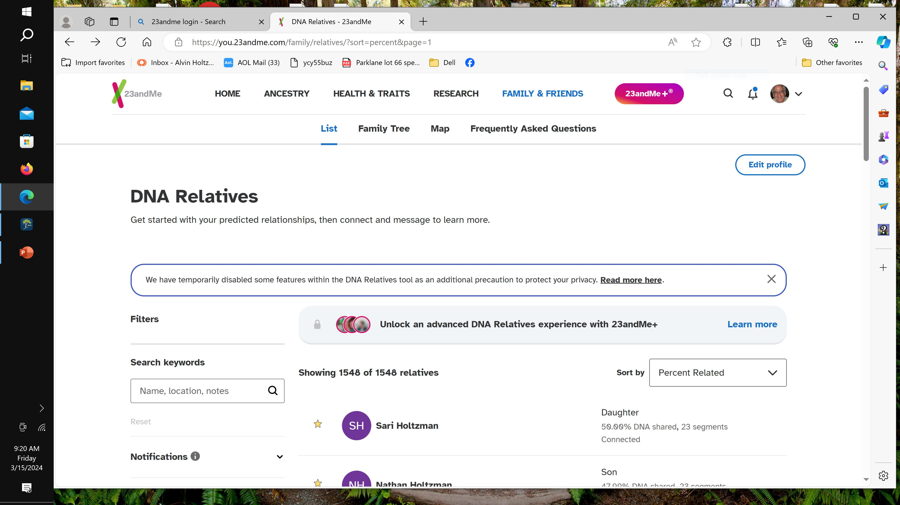
Notes:
Let’s move to 23andme. Currently 23andme has removed for now the Chromosome Browser but did reinstate the shared matches tool. To identify the largest segments and maintain the 100 cM threshold, you can scroll down until you see DNA sharing at 1.4%. Then identify these matches with the fewest segments. That would get you the highest average segment length. 1.4% equals about 100 cM. If you want to get a 12 segment length average you have to look for matches that share 8 segments or less with you.

Slide 25
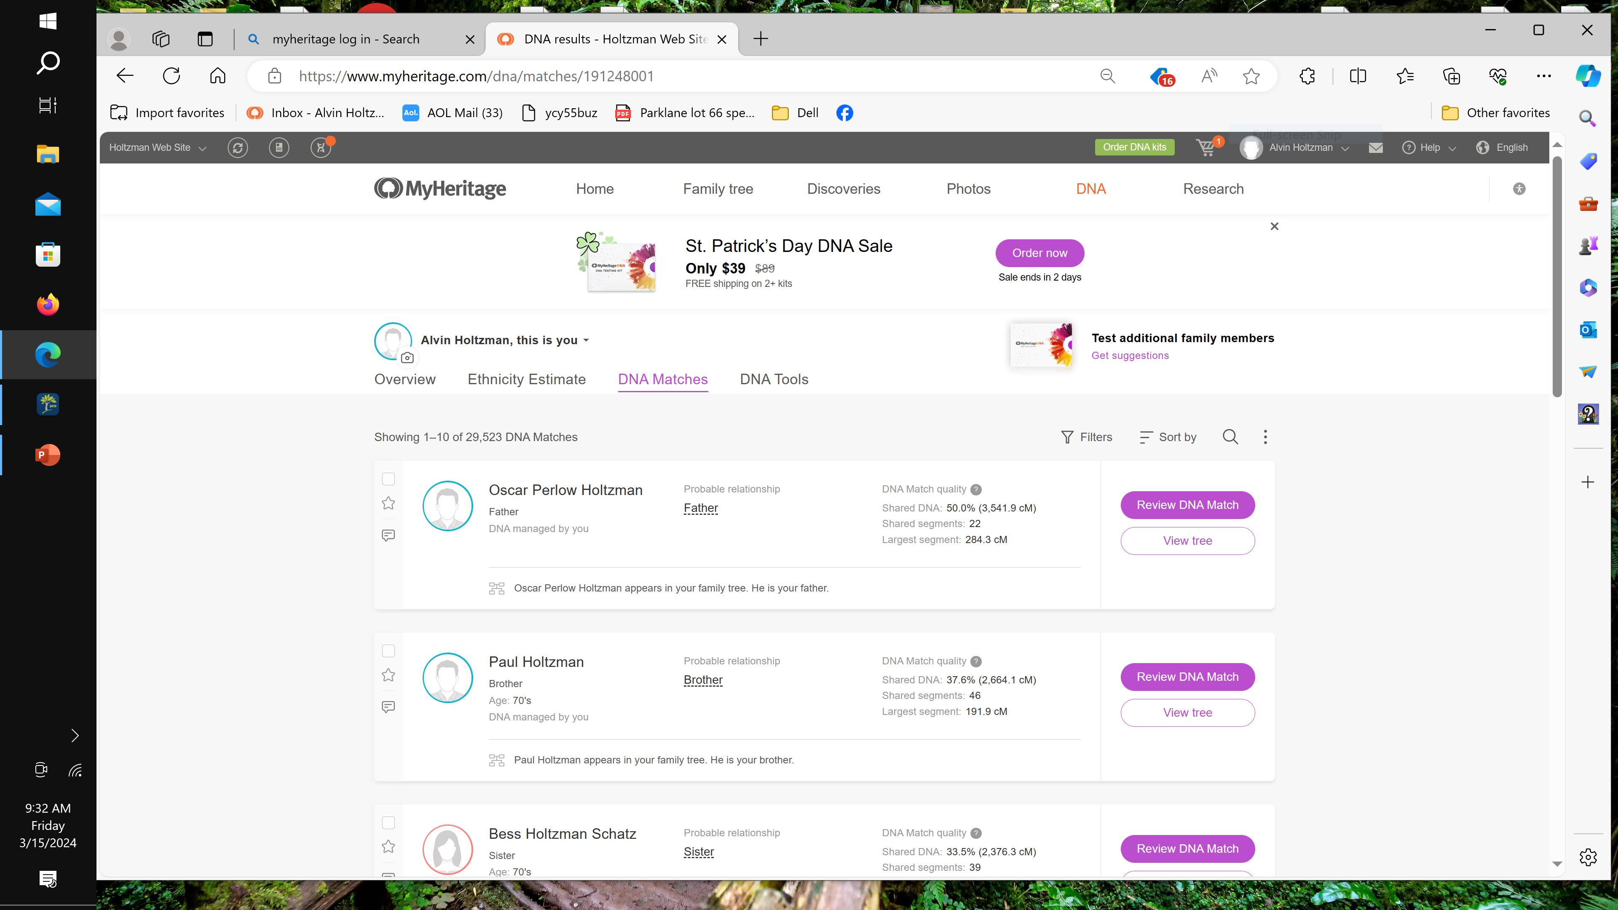
Notes:
Now onto MyHeritage. They offer lots of great analytical tools.

Slide 26
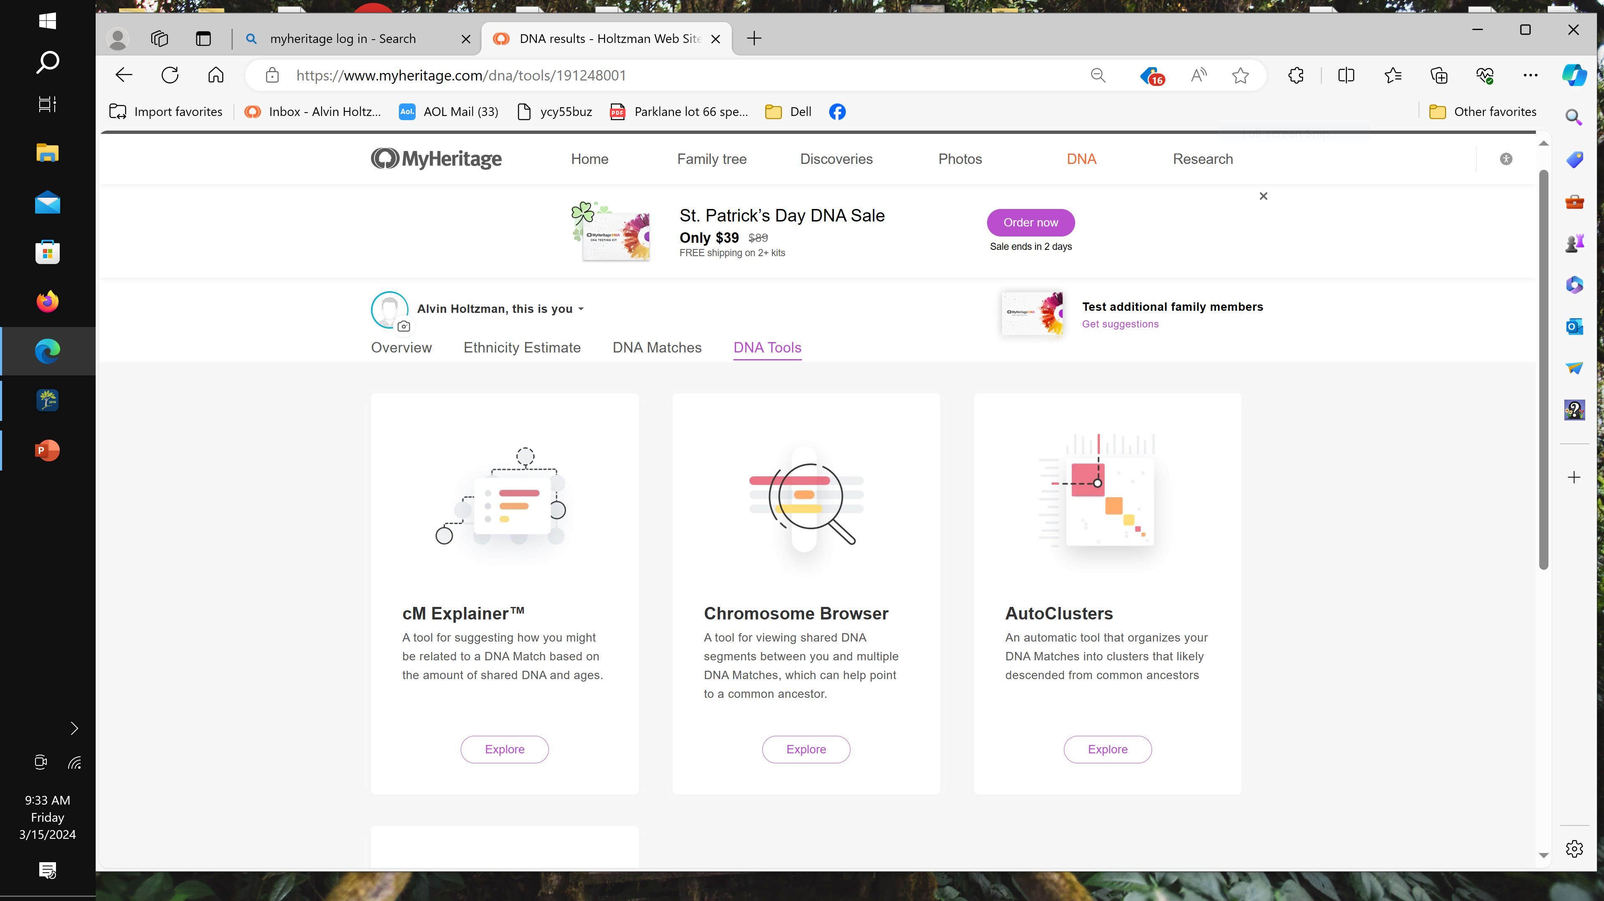
Notes:
Among their best tools are cM Explainer, Chromsome Browser and Autoclusters.

Slide 27
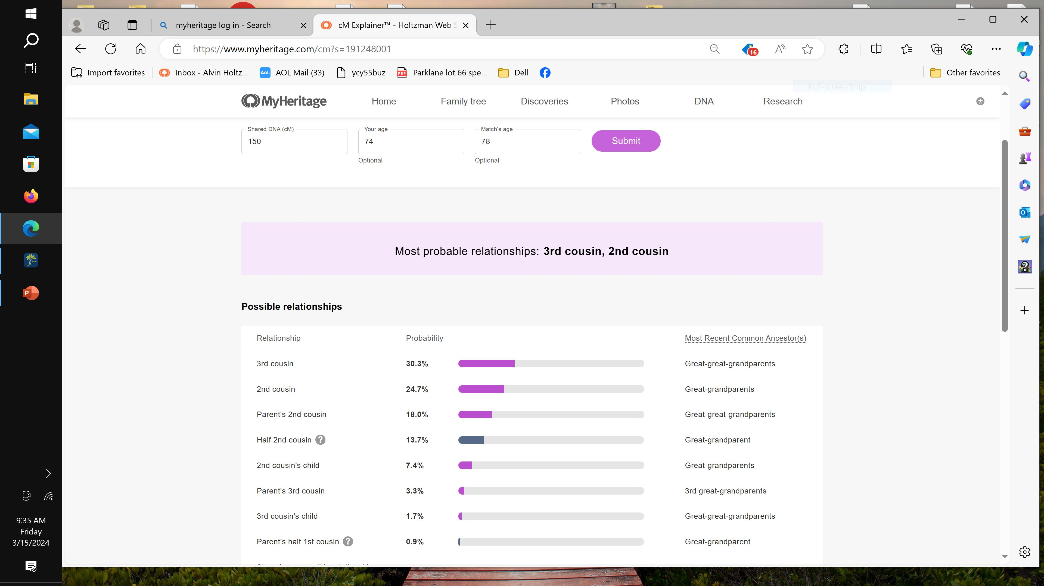
Notes:
Let’s take a look at the cM Explainer. At the top of the page, I input my shared cM with another match. Then I input my age and by matches age. Based on that info, MyHeritage can project our relationship.

Slide 28
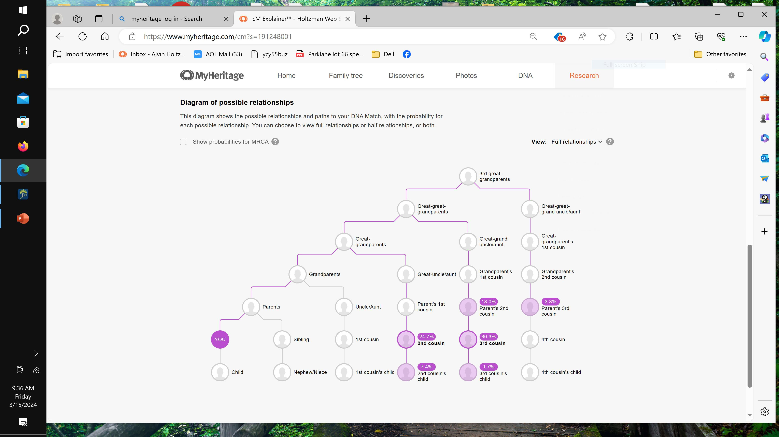
Notes:
And below that relationship calculator, they nicely illustrate the potential links via this tree.

Slide 29
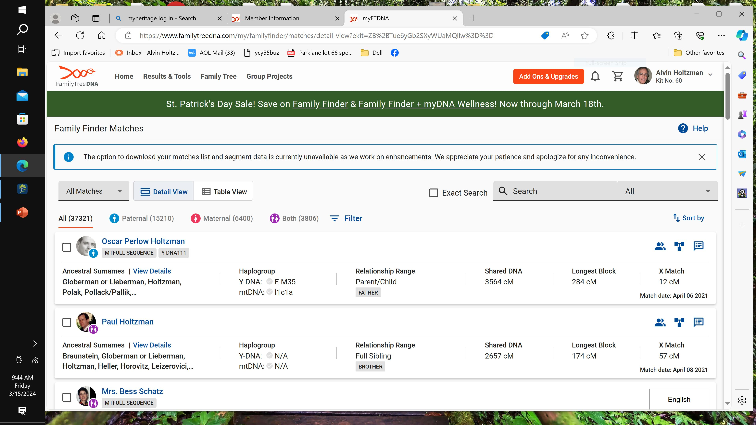
Notes:
Here’s FamilyTreeDNA. You can see I currently have 37,321 matches. How many do you have? They also predict paternal, maternal or both. So of the 37,321 matches, 15,210 are considered to be paternal side matches, 6,400 are considered to be maternal side. And 3,806 matches are related to me through both my parents. These three numbers don’t add up to my total matches because the DNA sharing may be too little to project. By clicking “sort by” you have the opportunity to view or categorize your matches.

Slide 30
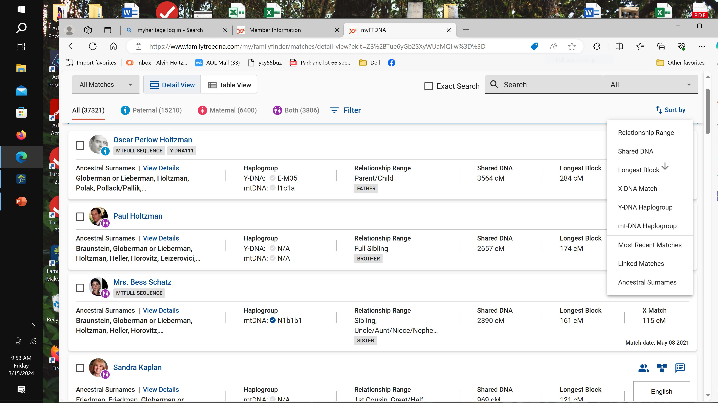
Notes:
This is what that looks like. Some of those sorting tools can be very useful.

Slide 31
More DNA Analytical Tools
*GEDmatch.com AutoCluster Endogamy
*DNAPainter.com WATO+
More DNA Analytical Tools
Notes:
GEDmatch just introduced a new tool called AutoCluster Endogamy. It’s in their Tier One stable of tools which requires a payment. You can pay them either $15 for one month or $120 per year. DNAPainter just introduced the WATO+ tool. This plus feature attempts to address the endogamous population. The normal WATO tool was not helpful to endogamous testers.

Slide 32
Contact
Alvin Holtzman
inkwell177@aol.com
Notes:
Thanks for listening. Hope you got something out this. Feel free to contact me.

